Slide 1
INTRODUCTION
UNDERSTANDING THE VALUE OF DIGITAL CURRENCY
Traditional online payment gateways for fiat currencies are owned by organizations. They hold your money for you, and you need to ask them to transfer it on your behalf when you want to spend it.
In crypto currencies, there isn't an organization. You, your friends, and thousands of others act as your own banks by running free software. Your computer connects with other people's computers, meaning you communicate and transact directly – no middlemen required !
This document has been compiled to provide an overview of the implications of blockchain technology on the economy and the historical performance of crypto currency since inception.

Slide 2
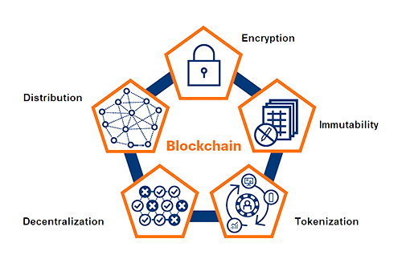
WHAT IS BLOCKCHAIN TECHNOLOGY ?
BLOCKCHAIN IS A DISTRIBUTED LEDGER
IT IS SIMILAR TO THE LEDGER THAT BANKS HOLD TO MONITOR ALL DIGITAL TRANSACTIONS IN CURRENT FIAT CURRENCY SYSTEM
A DISTRIBUTEED LEDGER, UNLIKE THE BANKS LEDGER HAS NO CENTRAL AUTHORITY CONTROLLING IT .
ITS PEER TO PEER WHICH MEANS ANYONE IN THE NETWORK CAN ACCESS WHEN, WETHER, WHERE &WITH WHOM TO TRADE DATA FOR VALUE

Slide 3
WHAT IS BITCOIN ?
Digital cash that is encrypted and distributed across a global ledger called the blockchain.
A Peer-to-Peer Electronic Cash System.
Currency for the people that has no central control and allows very low remittance fees.
Replaces trust in institutions with encrypted mathematics.
The Bitcoin blockchain ledger is distributed across the entire network of Bitcoin users.
Everyone in the network can see it and trust that what is on it is correct.
Any transaction made using Bitcoin is therefore recorded on the Bitcoin ledger and sent across the whole Bitcoin network for everyone to see.

Slide 4
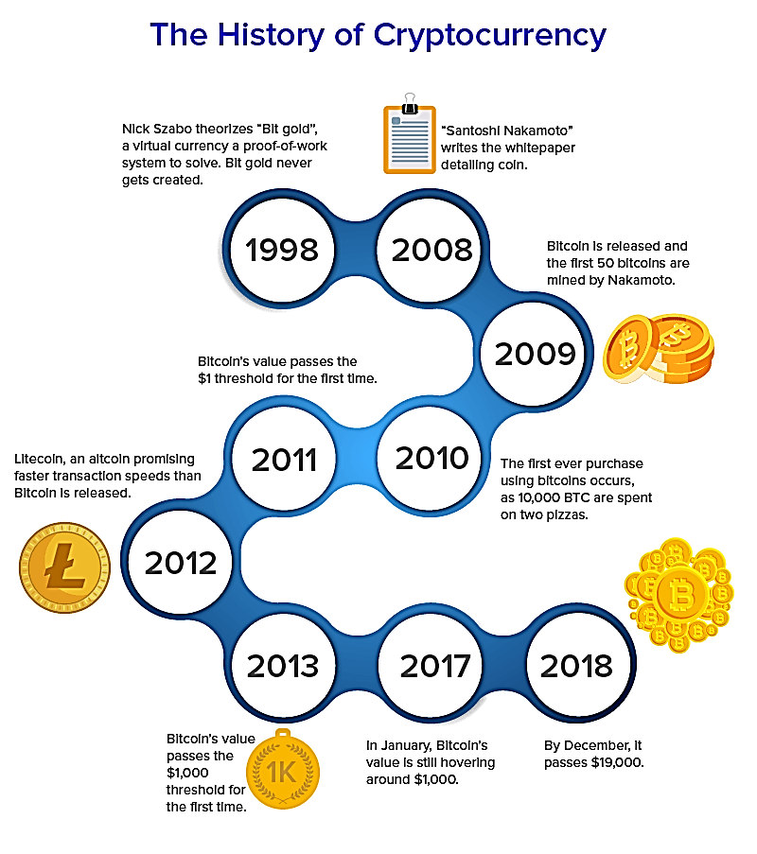
HISTORY & EVOLUTION OF CRYPTO CURRENCY
Cryptocurrency may often seem like an entirely new phenomena, but the concept of digital cash has actually now been around for almost four decades.
In 2008, Satoshi Nakamoto released the first successful Electronic Cash System today known by most simply as the Bitcoin whitepaper.
Nakamoto recognized that decentralisation was key to the dream of digital cash – a medium of exchange built for the internet, one that was optimized to exploit all of its potential to enable faster and cheaper transactions, and to solve historic issues in the financial system.
Satoshi also designed the entire Bitcoin system in an ‘open source’ manner - this means the code is available for everyone to inspect and see.
Nakamoto’s innovation that made Bitcoin possible was blockchain, which is the underlying technology on which the majority of crypto currencies are based

Slide 5
RELATIONSHIP BETWEEN BLOCKCHAIN AND BITCOIN
BLOCKCHAIN
BITCOIN
Blockchain technology isn’t only related to crypto currency like bitcoin
You can theoretically store any data on a blockchain
Companies across a variety of industries are using it for different tasks, such as keeping track of goods through the supply chain. However, crypto currency is certainly its most prominent application
AN ALGORITHM THAT SERVES AS AN IMMUTABLE DISTRIBUTED LEDGER
IMMUTABLE: CANNOT BE DESTROYED
DISTRIBUTED: NO CENTRAL AUTHORITY, PEER TO PEER NETWORK
LEDGER: DATA SET

Slide 6
HOW CAN BUSINESS OWNERS CAPITALIZE ON BLOCKCHAIN TECHNOLOGY
MEDIUMS/METHODS
APPLICATIONS
SMART CONTRACTS: Decentralized Autonomous Organizations which hold a complete set of rules that define the operations of an entire operational function.
Decentralized business models give a company the ability to profit from their internal process and data.
Secure algorithms that are self executing and provide potential to boost supply chain efficiency.
STORING DATA : Census of populations used to determine federal government fund allocation.
FACILITATES TRUST: Urban farming , life insurance and disbursement of inheritance
SOFTWARE LIBRARIES: Kidney transplant waiting list optimization. Geography and time problems solved.
AUTHENTICATION: Refugee identification and monitoring systems that resolve the problems of immigrants settling in a new country.

Slide 7
HOW IS BITCOIN CURRENTLY ISSUED AND REGULATED
Where fiat currencies are issued by central banks, new Bitcoins are "issued" to miners via a block reward for solving a block.
They do this by using special hardware to solve a complex computational problem, which produces a seemingly-random 64 character output. This output is known as a 'hash'.
After successfully mining a block, miners are rewarded with newly-created Bitcoins and transaction fees.
BITCOIN HALVING IS A RULE IN THE BITCOIN PROTOCOL THAT INTRINSICLY CONTROLS THE SUPPLY OF BITCOIN.
There is also a cap on the number of Bitcoins that will ever be in circulation. (21 Million)
Trust is the foundation of any successful monetary system. One of the most important factors engendering trust is governance, or the process by which changes are implemented to the protocol over time.

Slide 8
WHY IS CRYPTO WORTH INCLUSION IN YOUR INVESTMENT PORTFOLIO ?
The high growth potential provides an opportunity to make smart/profitable near and midterm investments.
In unsettling times, such as the global pandemic we are currently facing it serves as a solid hedge against inflation of the existing fiat reserve currencies.
Fiat tokens issued by central banks and governments have been used for years side by side process tokens (Apple pay, paypal, etc) and complementary tokens such as credit card reward points.
Blockchain amplifies the usability and adaptability of tokens turning them into robust mechanisms for creating and exchanging value in peer to peer networks.

Slide 9
METHODS OF PROCUREMENT AND EXPOSURE TO THE TECHNOLOGY
If you’re not a miner, you will likely need to buy crypto currency through a broker or exchange.
Firstly you will need a wallet – an online app that can hold your currency. (Luno, Coinbase, Binance) etc
This wallet will require both a private and a public key that define your identity on the blockchain.
Your private key is the "ticket" that allows you to spend your bitcoins.
Users are typically given a seed phrase that encodes the same information as private keys.

Slide 10
METHODS OF PROCUREMENT AND EXPOSURE TO THE TECHNOLOGY
A wallet program, will secure your private key for you, let you easily perform transactions, and make it easy for you to share your public key with others so that they can send you money.
Both a wallet and an exchange can often be found in one place, for example, the Luno platform.
Other methods of exposure that could be considered are acquiring stocks in the NYSE that are related to cryptocurrency , e.g (GBTC, RIOT, MARA, SQ, NVIDIA, ETH)

Slide 11
OTHER FORMS OF EXPOSURE TO CRYPTOCURRENCY
Crypto Mining companies stocks e.g. Marathon (MARA) & (RIOT)
Alternative crypto currencies, similar to penny stocks in the stock exchange.
Stable coins such as the JP Morgan chase stable coin.
The Grayscale bitcoin and Ethereum Trust which is procured at a premium and the preferred choice for institutions and older investors.
An example of an entirely new crypto currency is Ether, which is the crypto currency issued on the Ethereum blockchain.
Where Bitcoin stores a list of balances and transactions on its blockchain, the Ethereum blockchain is designed to store different types of data.
Ether block chain enables us to provide decentralized applications to improve the industries of finance, personal information storage, governance and more by using the transparent nature of a block chain.

Slide 12
INSTITUTIONAL INVESTMENT AND ITS IMPLICATIONS FOR CRYPTOCURRENCY
You can’t talk about institutional investment without mentioning the biggest bull of them all – asset management giant, Grayscale.
Today, Grayscale has over 500,000 BTC under management at time of writing. That’s almost 3% of the current circulating supply, 80 % of this comes from Institutional investors
The influx of institutional investment is hugely positive for a number of reasons. High among these is the stature of those involved. Anyone buying bitcoin is a good thing, but such well-established and well-respected entities placing such large bets on its future is a huge show of confidence in both its potential and its status as a store of value

Slide 13
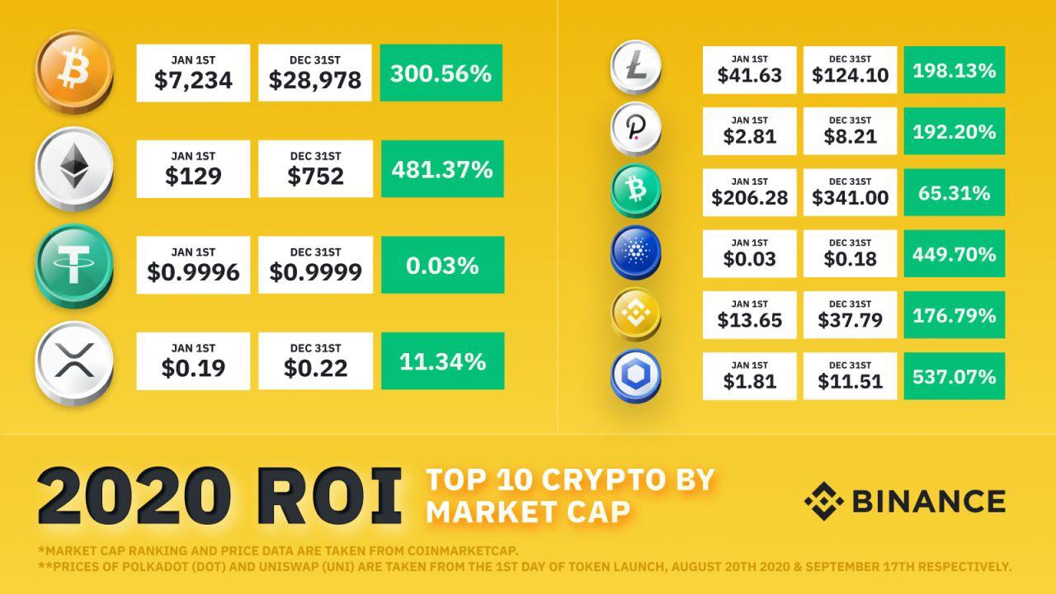
RISK ANALYSIS AND ROI FOR CRYPTO IN 2020
One of challenges of maintaining a distributed record of transactions is security -- specifically, how to have an open and editable ledger while preventing fraudulent activity.
To address this challenge, Bitcoin introduced a novel process called Mining (using the consensus algorithm “Proof of Work”) to determine who is “trusted” to make updates to the shared record of transactions.
This process is very secure, but it demands enormous computing power and energy consumption as users essentially “burn money” to solve the computational puzzle that earns them more Bitcoin.
Considering the punitive burn-reward ratio it is evident that it is in the best interest of validators to keep honest records.
Consumer Price Index is estimated to contain about 3.5% inflation by March 2021. This implies that bitcoin will continue its bull rally through 2021. Stable coins and alt coins are predicted to follow the same trend.
Price volatility of bitcoin is mainly a result of institutional owners selling off without corresponding buy back from retail investors.

Slide 14
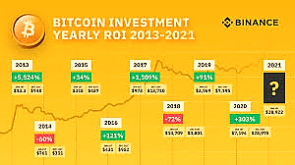
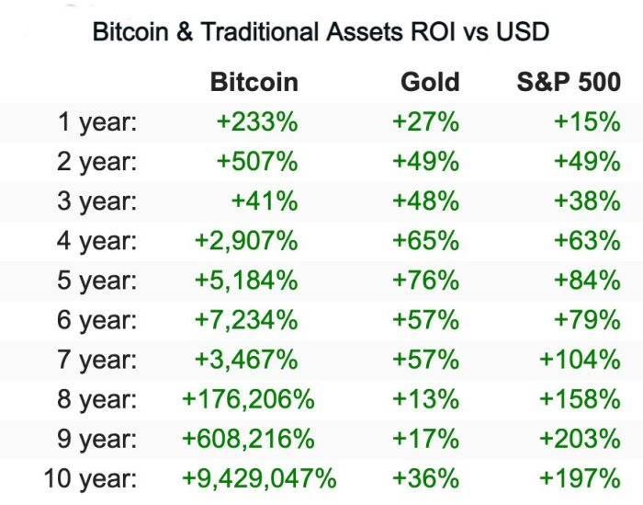
ROI HISTORY FOR CRYPTO CURRENCY INVESTMENT

Slide 15
REFERENCES _ ARTICLES AND VIDEOS
LINKS TO ARTICLES
LINKS TO VIDEOS
https://www.luno.com/blog/en/post/will-2021-be-even-bigger-for-bitcoin-here-are-the-crypto-trends-to-watch-next-year
https://theconversation.com/ethereum-what-is-it-and-why-has-the-price-gone-parabolic-153733
https://www.investopedia.com/tech/most-important-cryptocurrencies-other-than-bitcoin/
https://www.luno.com/blog/en/post/bitcoin-transaction-delays?utm_source=LinkedIn&utm_medium=Organic&utm_campaign=Blog_BTC_delays_LN
https://www.luno.com/blog/en/post/is-bitcoin-greener-than-gold?utm_source=LinkedIn&utm_medium=Organic&utm_campaign=Blog_BTC_energy_LN.
https://www.luno.com/blog/en/post/institutional-investment-comes-to-bitcoin?utm_source=LinkedIn&utm_medium=Organic&utm_campaign=Blog_institutional_LN.
https://youtu.be/PiX2D1LZfgQ (Bitcoin Double Spend problem)
https://youtu.be/IdAQU9hxyVo (Insights of a formidable investor on bitcoin and cryptocurrency)
https://www.youtube.com/watch?v=ZE2HxTmxfrI (Smart contracts simply explained)
https://www.youtube.com/watch?v=YWhuMgrgsZE (Smart contracts and ethereum)
https://www.youtube.com/watch?v=pA6CGuXEKtQ (How smart contracts will change the world)
https://www.youtube.com/watch?v=Pl8OlkkwRpc (How blockchain is changing money and business)

Slide 16
RECOMMENDED READING – BOOKS
THE REAL BUSINESS OF BLOCKCHAIN.
D. FURLONGER (2019)
THE AGE OF CRYPTOCURRENCY
PAUL VIGNA (2015)
CRYPTOASSETS
JACK TATAR (2017)
BLOCKCHAIN REVOLUTION
DON TAPSCOTT (2016)
BITCOIN BILLIONAIRES
BEN MEZRICK (2019)

